Slide 1
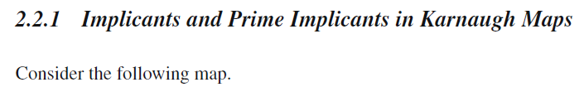
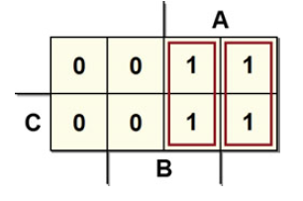

AB
C
00
01
11
10
0
1
Each one is an implicant because if AB’ or AB equals 1, the function U also equals 1.

Slide 2
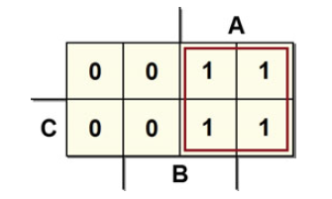
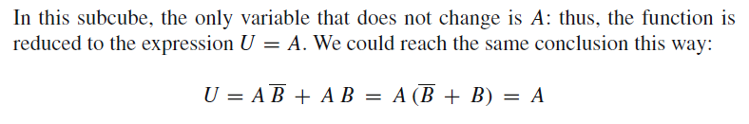
Let’s now consider the two-dimensional subcube that comprises all the 1s as in the following figure:
AB
C
00
01
11
10
0
1
The simplification is possible because A’B and AB are not prime implicants while A is. To obtain the best grouping, we must locate the largest possible subcubes. If there is no largest subcube that completely covers what we are considering, it is called a prime implicant.

Slide 3

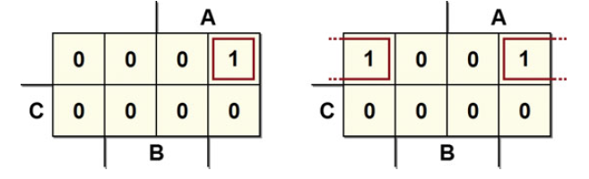
AB
AB
C
00
01
11
10
C
00
01
11
10
0
0
1
1
Despite appearances, the two cells are logically adjacent, in the map on the right.
The map is a representation on a two-dimensional space of a multidimensional cube. So, we need to imagine the map as a piece of paper that can be folded over itself vertically and horizontally; the upper and lower edges and the right and left edges are adjacent to each other. As proof, note that only variable A changes between each two pair of cells.

Slide 4
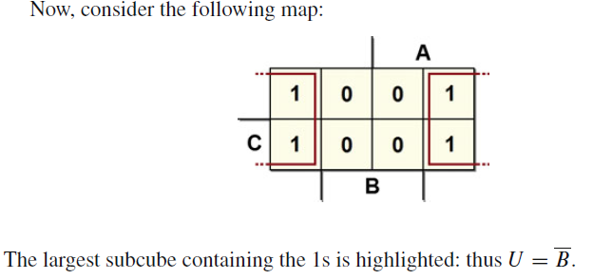
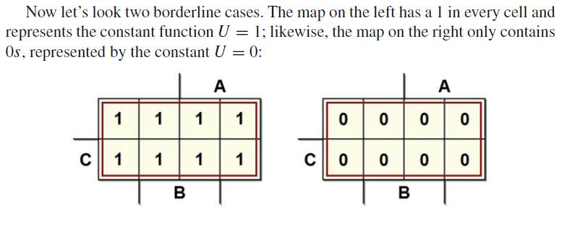
AB
C
00
01
11
10
0
1
AB
AB
C
00
01
11
10
C
00
01
11
10
0
0
1
1

Slide 5
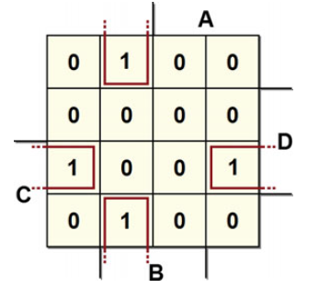
In a three-variable map, all the minterms that differ by one variable are represented on the map by adjacent cells.
This also holds for four-variable maps, as in the following example:
AB
CD
00
01
11
10
00
01
11
10

Slide 6
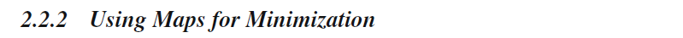
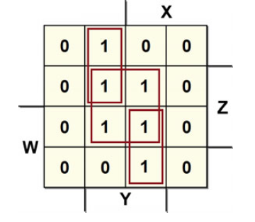
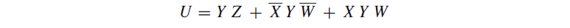
Let’s define the essential prime implicant as the only prime implicant that contains a certain 1 on the map.
On the following map, for example, there are two order-1 essential prime implants and one order-2 essential prime implicant.
XY
WZ
00
01
11
10
00
01
11
10
The cells with the 1s can be considered more than once. This is useful for finding higher order subcubes. We obtain the synthesis:

Slide 7
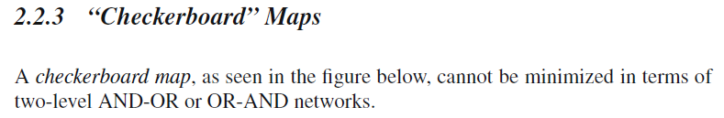
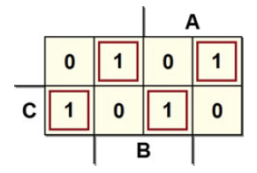
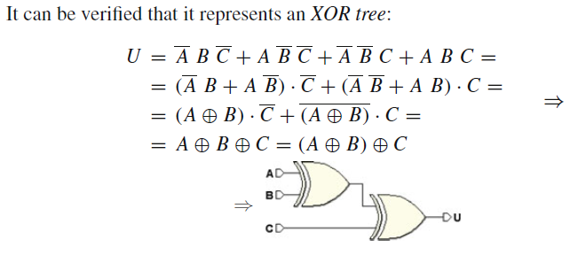
By using the maps, we obtain the minimum synthesis by taking only the essential prime implicants.
AB
C
00
01
11
10
0
1

Slide 8
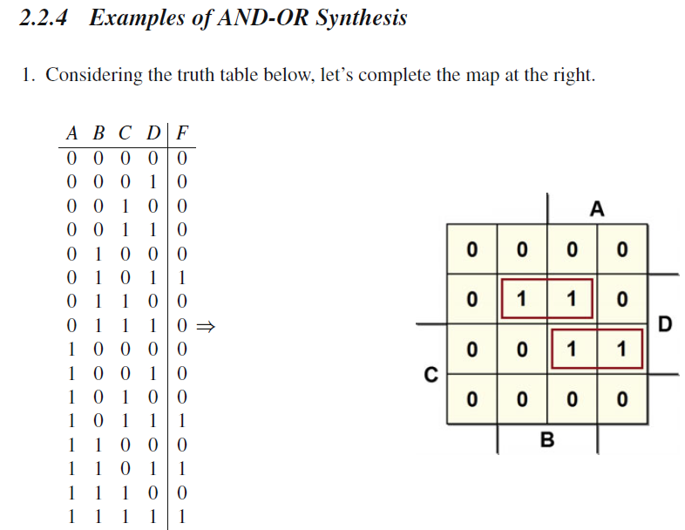
AB
CD
00
01
11
10
00
01
11
10

Slide 9
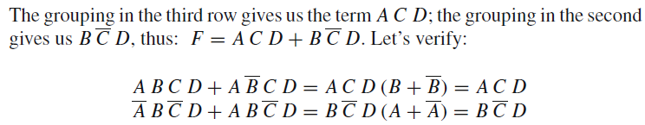
AB
CD
00
01
11
10
00
01
11
10

Slide 10
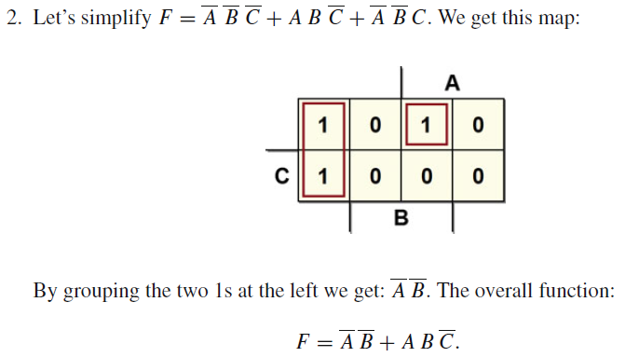
AB
C
00
01
11
10
0
1

Slide 11
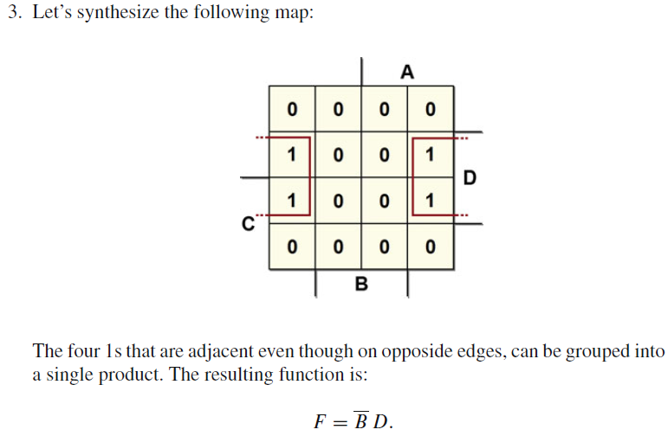
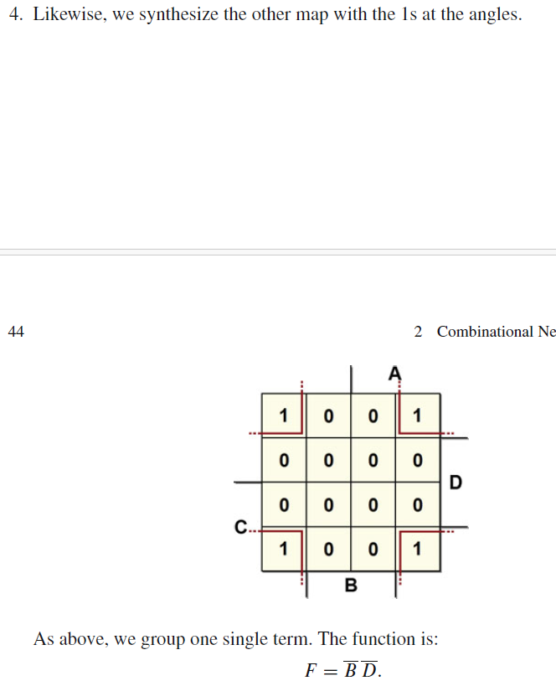
AB
CD
00
01
11
10
00
01
11
10
00
01
11
10
00
01
11
10

Slide 12
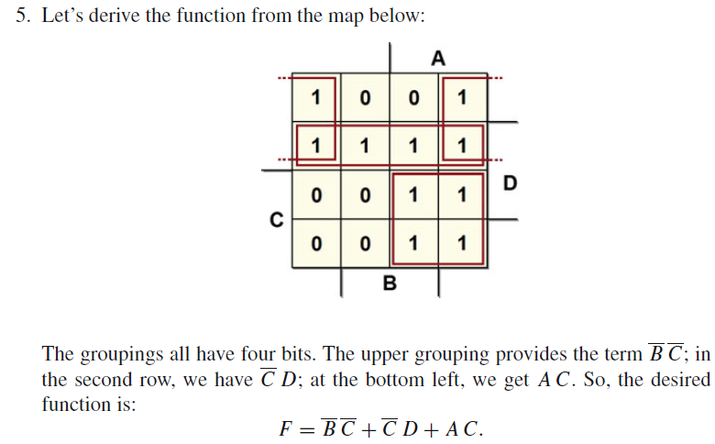
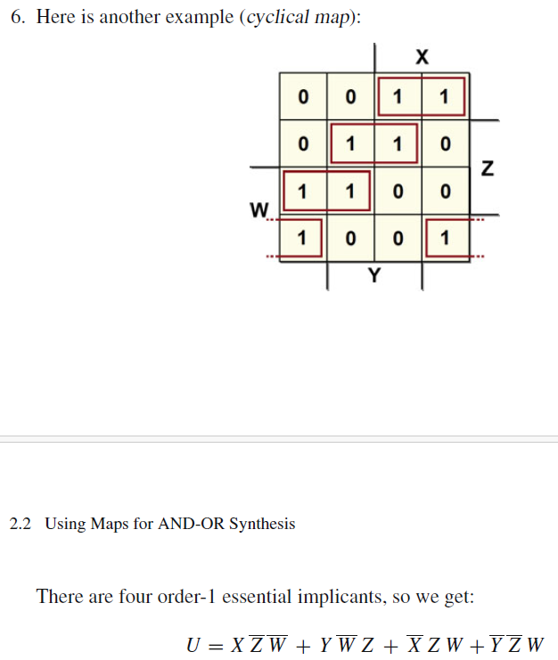
AB
CD
00
01
11
10
00
01
11
10
AB
CD
00
01
11
10
00
01
11
10

Slide 13

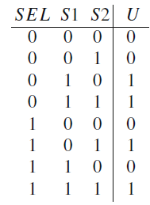
In an AND-OR synthesis, we synthesize the 1s of the function through the AND of the input variables. They are direct if the variable equals 1 and negated if it equals 0. Then, all outputs of the AND gates are OR-ed together.
In the OR-AND synthesis, we synthesize the 0 of the function through the OR of the input variables (direct if 0 and negated if 1) and all the ORs end up in an AND.
To minimize the OR-AND synthesis using Karnaugh maps, the property of logic adjacency is still valid. Let’s take the two-input channel multiplexer as an example, but use the OR-AND technique. Here is the truth table:

Slide 14
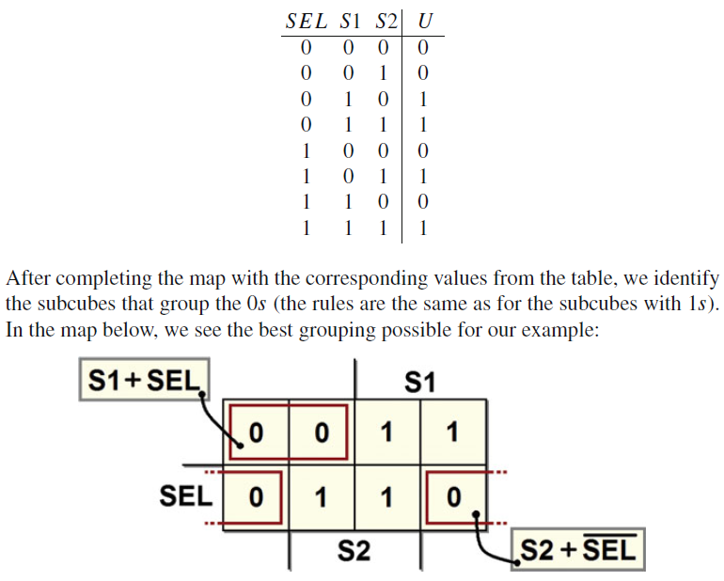
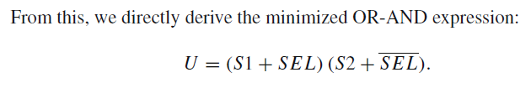

Slide 15
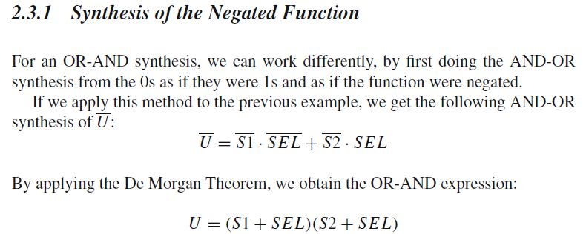
*Note that it is not possible to obtain the OR-AND synthesis by applying the principle of duality directly to the AND-OR expression.

Slide 16

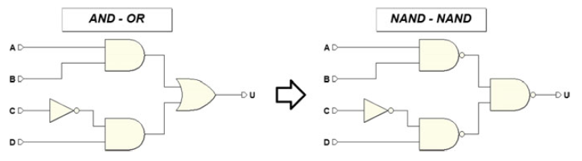
Once we have the AND-OR synthesis:
we can implement the function with a network composed exclusively of NANDs (NAND-NAND synthesis) by substituting every OR or AND with a NAND, as in the figure below:

Slide 17
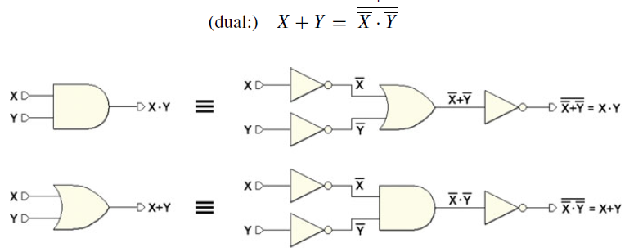
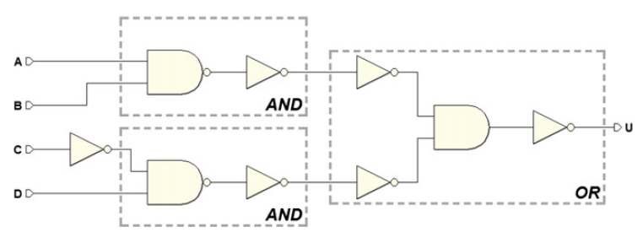
PROOF:
Let’s substitute the ANDs on the left with NANDs followed by NOT.
Then, let’s apply De Morgan’s Theorem to the OR gate, transforming it into AND, whose inputs and output are negated:

Slide 18
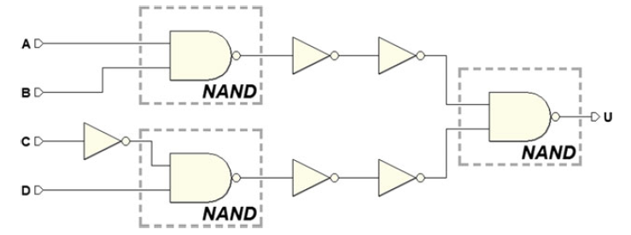
PROOF:
Let’s merge the AND gate with the NOT that follows and obtains a NAND,
and then separates the two NANDS on the left from the NOTs.

Slide 19
PROOF:
Let’s merge the AND gate with the NOT that follows and obtains a NAND,
and then separates the two NANDS on the left from the NOTs.
Finally, when we eliminate the double negation, we get the NAND-NAND network.

Slide 20

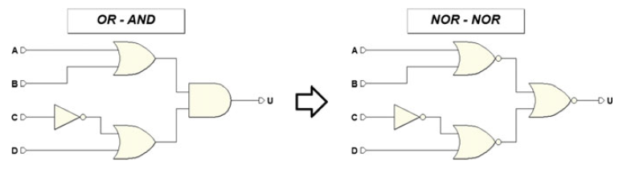
Starting from an OR-AND network, we substitute each OR or AND with a NOR gate and get a NOR-NOR synthesis as in the example below.
The proof is analogous to the NAND-NAND network.

Slide 21
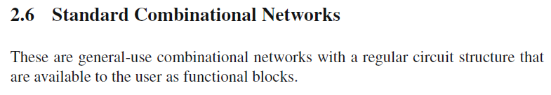
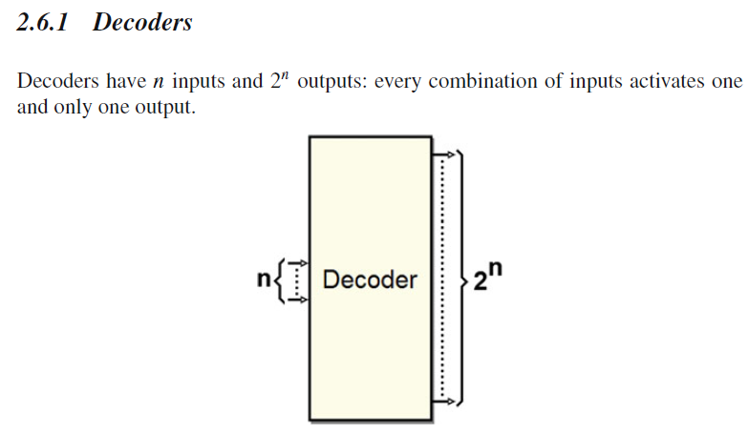
Decoders are very important because they are very commonly used. They allow us to use an identification number to identify and/or select the elements of a system and operate on them, as with memories.
*Decoders are used to select specific memory locations in RAM and ROM chips, allowing data to be read from or written to specific memory locations.

Slide 22
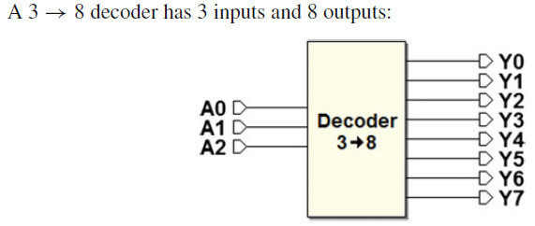
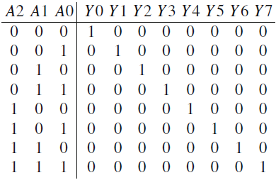
As we can see in the truth table below, output activation occurs in order. The combination A2A1A0 = “000” activates the output Y0 and A2A1A0 =“111” activates output Y7:

Slide 23
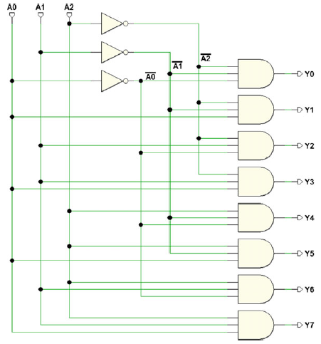
Synthesizing a truth table with eight outputs requires using a combinational network for each output. Here, each output is activated by a single combination of inputs, so maps are not useful since each output calls for only one minterm.
The figure below shows the synthesis of the 3 → 8 decoder:

Slide 24
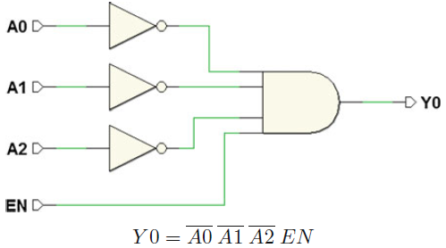
Decoders generally have one enable input.
When the decoder is enabled, it behaves as described above;
otherwise, no output is activated.
The figure below shows the synthesis of the output Y0, with the enable input EN:

Slide 25
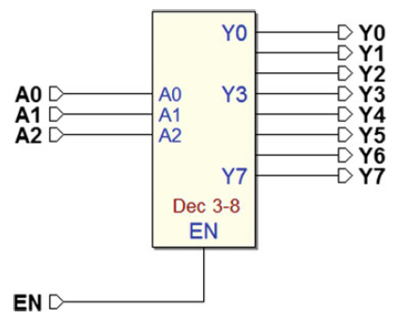
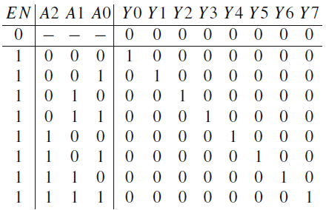
The figure below shows the 3 → 8 decoder, along with its truth table (notice the functionality of the EN input):

Slide 26
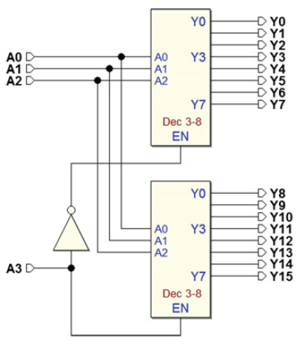
More than one decoder can be connected in order to form a larger one.
For example, with two 3 → 8 decoders we get a 4 → 16 decoder:

Slide 27
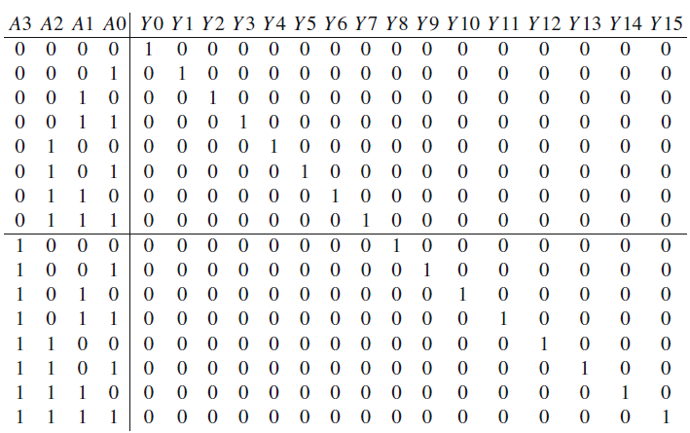
The truth table below can be divided into two parts: the upper part where the input A3 = 0 and the lower part where A3 = 1.
Upper 3 → 8 decoder that generates the first eight outputs must be enabled (EN = 1) when A3 = 0;
and the other when A3 = 1.
A simple NOT, as we see in the logic diagram, does the job.

Slide 28
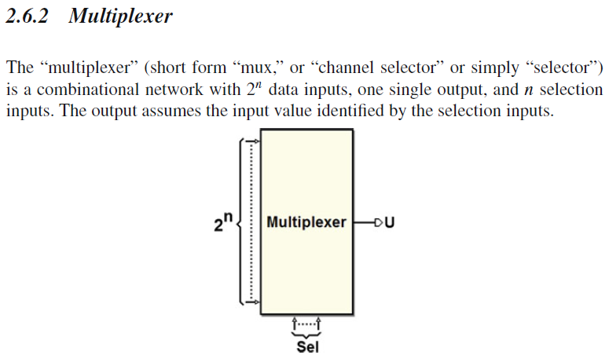
Multiplexers can select control signals from the CPU's control lines.
(Used in memory access, and arithmetic computations)
*Multiplexers are used in telecommunications, automotive manufacturing, and aerospace for optimizing data routing and signal management. Multiplexers can efficiently combine and select data or signals in various real-world applications.

Slide 29
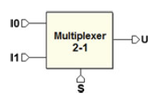
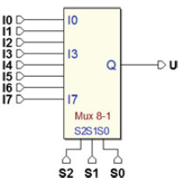
We’ve already seen the two-input channel selector and how it is created through logical gates.
In this case, input S selects which of the two I0 and I1 inputs will be reproduced as the output.
Let’s extend this concept to multiplexers with a higher number of inputs. In the figure below, three inputs S2, S1, and S0 control which of the eight inputs (I0..I7) will be brought over to the output.

Slide 30
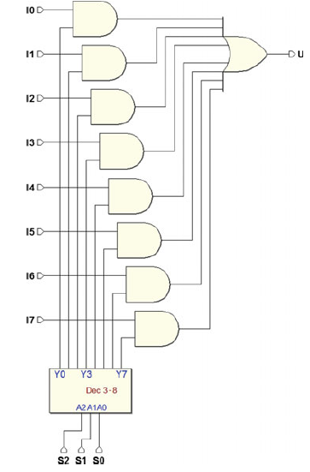
The network has eight data inputs and three selection inputs. It is impractical to do the synthesis through the truth table of a network with 11 inputs (providing 2048 rows in the table).
The concept of decoding can help here.

Slide 31
Sending the selection inputs to a decoder, we enable only one of the eight AND gates that transmit each of the eight inputs I0..I7 through the OR gate.
The concept of decoding can help here.

Slide 32
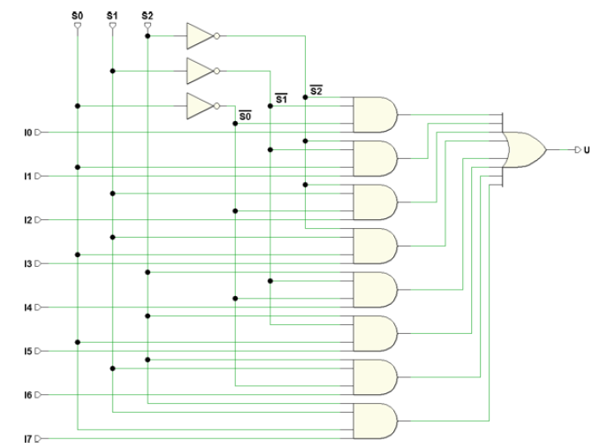
By just adding an input to each of the AND gates that generate the decoder’s outputs, we can get rid of the eight external ANDs. The result is that the network is reduced to just two levels, as in the next figure:

Slide 33
By just adding an input to each of the AND gates that generate the decoder’s outputs, we can get rid of the eight external ANDs.

